Slide 1
MUF SS19
Loss, Training and Training Set

Slide 2
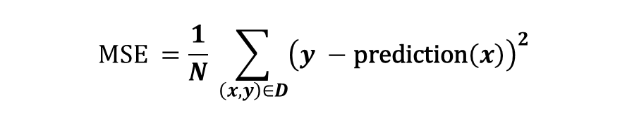
Mean Square Loss or How good is a prediction?
Given a data set D and a linear prediction with weights and bias, we can define so called mean square error (MSE):
$$MSE =\frac{1}{N} \sum_{\left(x,y\right)∈D}{{\left(y −\text{prediction}\left(x\right)\right)}^{2}}$$
Observation:
The MSE depends on the data set and the prediction function.

Slide 3
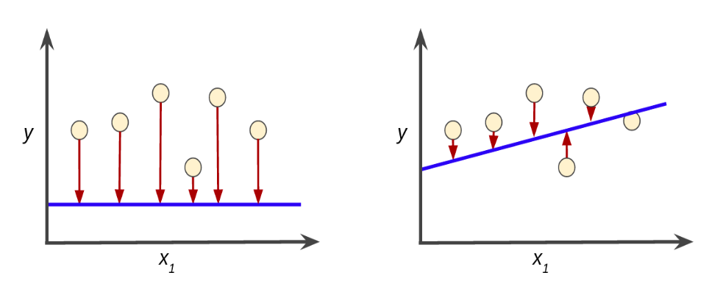
Example: d = 1, N = 6

Slide 4

Loss
Given a training set $D$and a prediction function, we can assign a positive number to the set of pairs
$$\left\{\left(y, \text{prediction}\left(x\right)) \right| \left(x,y\right)∈D \right\}$$
Such a number is called loss, if a big loss value indicates a bad model.

Slide 5
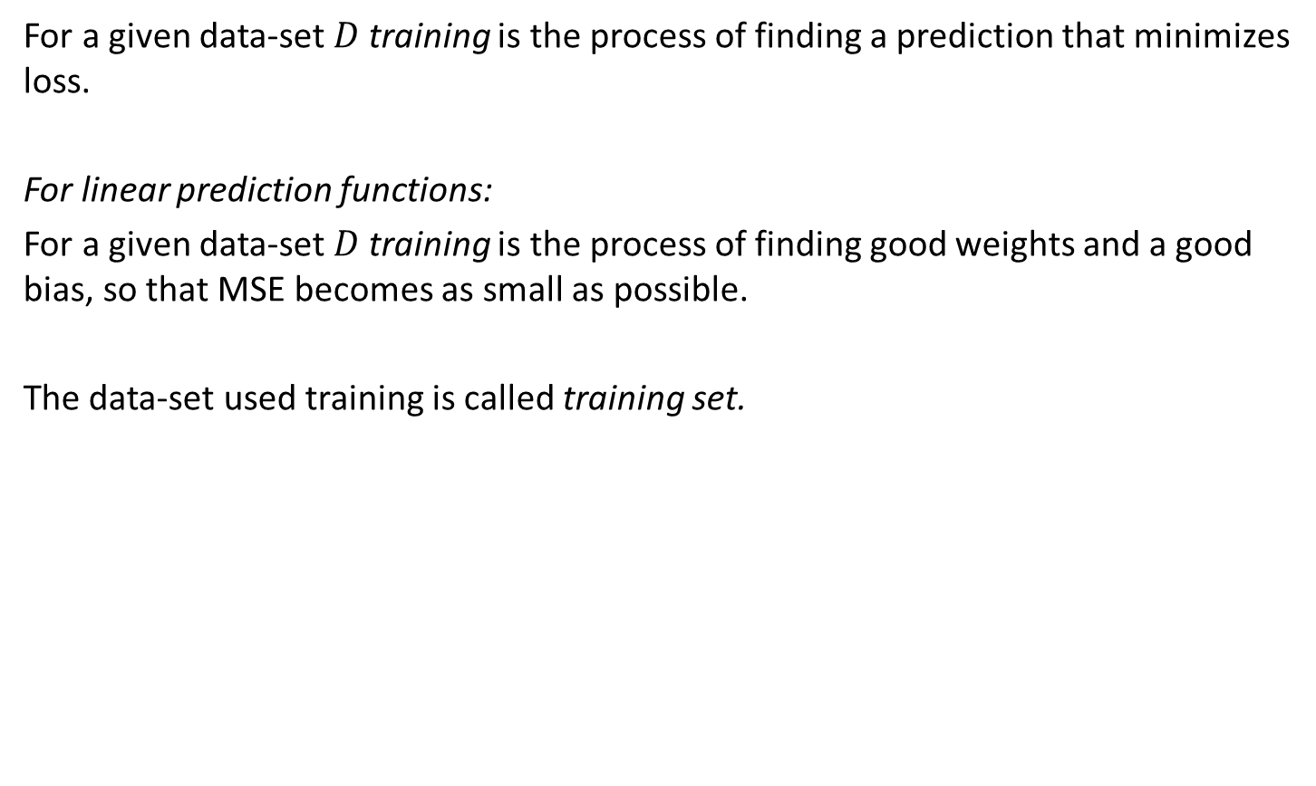
Training
For a given data-set $D$training is the process of finding a prediction that minimizes loss.
For linear prediction functions:
For a given data-set $D$training is the process of finding good weights and a good bias, so that MSE becomes as small as possible.
The data-set used training is called training set.

Slide 6
Iterative Training Approach (or: the hot and cold game)
Compute new parameters (weights and bias)
Prediction Function
Compute
Loss
Features (x)
prediction(x)
Labels (y)

Slide 7
Notes
Prediction functions are usually not linear!

Slide 8
Dataset, Training Set, Validation Set
Datasetv
Validation Set
20%
Evaluate
Prediction
Training
Set
Train
80%

